Slide 1
Computer Programming Internship Project Presentation
Spenser Franklin
7/1/20

Slide 2

Web Interface
When creating the website I wanted something easy to use and navigate.
I used a simple template without many layers as the base of my website.
My website has all of its content on one page except for the projects where you can choose to go to pages for each project to look deeper into them.

Slide 3
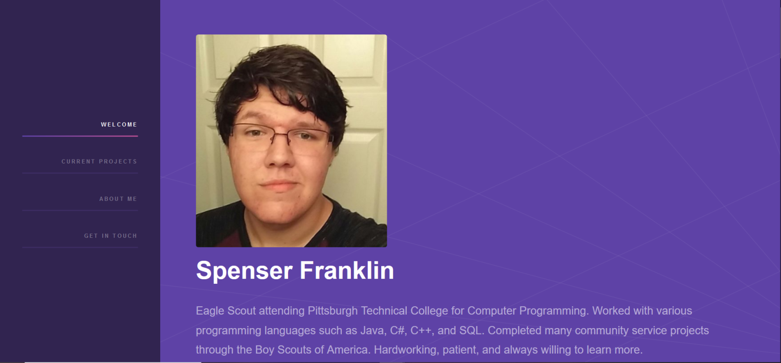

Web Interface
When entering the website you are greed with the page layout on the left, an image of me, and a little bit about myself.

Slide 4
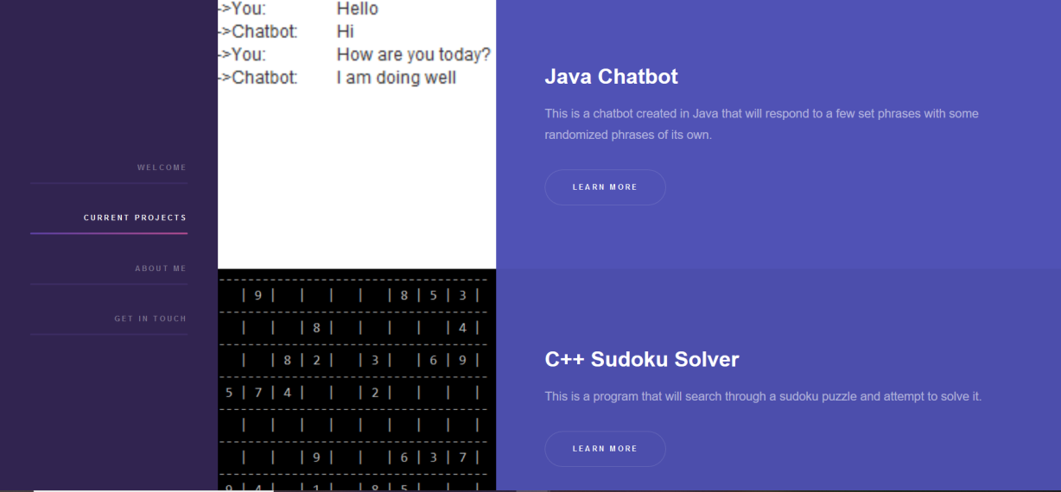
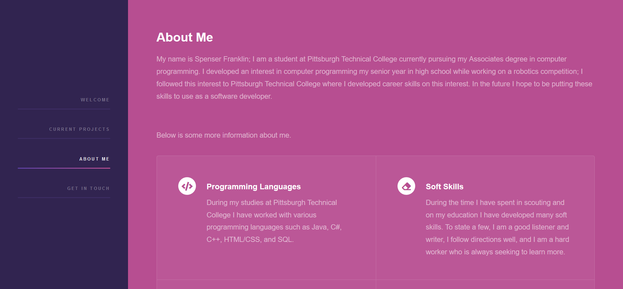
Web Interface
Further down the page you will find a list of my most recent projects, followed by a section that will allow you to learn more about me and some of my skills, finally at the bottom is a section with my contact information.

Slide 5
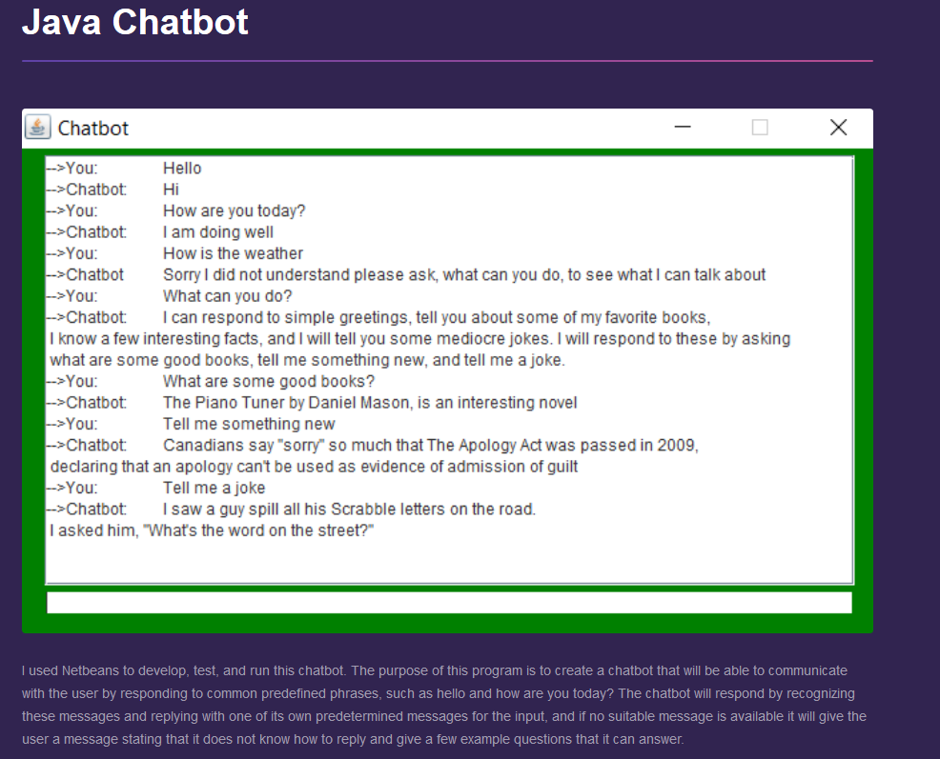
Web Interface
Finally in the current projects section if you click on the learn more button it will go to another page which you can get a more in-depth look at that project.

Slide 6
Java Chatbot
The first project I created was a chatbot in Java, I created this using Netbeans.
The purpose of the program is to create a chatbot that will be able to communicate with the user by responding to common predefined phrases, if no suitable message is available it will give the user a message stating that it does not know how to reply and give a few example questions that it can answer.

Slide 7
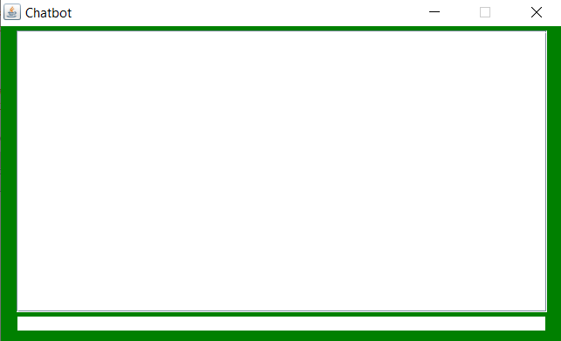
Java Chatbot
The program runs through a JFrame and allows the user to type to the chatbot.
This is were the program gets the input from the user.

Slide 8
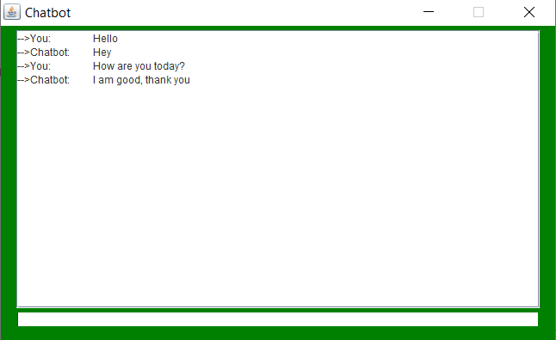
Java Chatbot
The chatbot then takes that input and checks it against a 2D array that has statements and phrases it can answer stored.
If it is a message it can answer it will respond with a random predetermined response.

Slide 9
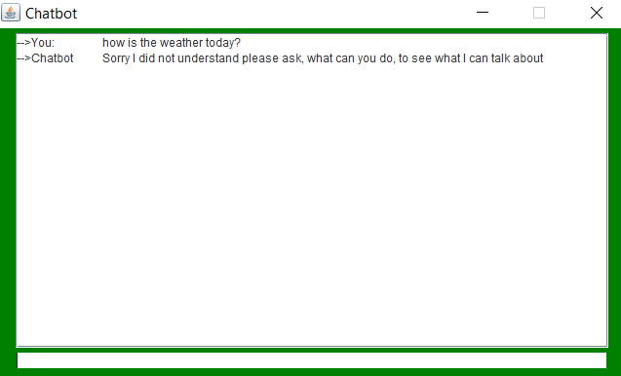
Java Chatbot
If the input is something that is not stored in the array the chatbot will respond with a message that it does not know how to answer and will list some messages that it can answer.

Slide 10
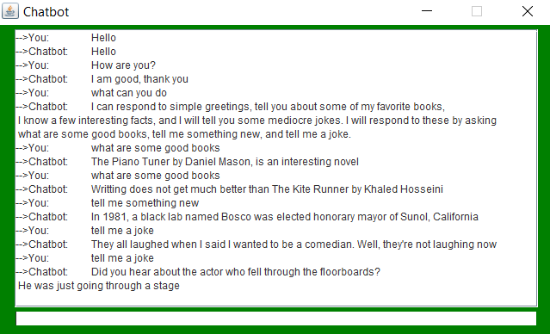
Java Chatbot
Once it is all put together a full conversation with the chatbot will look like this.

Slide 11
C++ Sudoku Solver
My second project was a Sudoku solver written in C++, I used Visual Studio to create this program.
The goal of this program is to attempt to solve a Sudoku puzzle by filling in each empty space and then backtracking if the wrong number was placed, it will then repeat this until the puzzle is solved or it deems it unsolvable.

Slide 12
C++ Sudoku Solver
This program visits the empty cells in order, filling in digits sequentially, or backtracking when the number is found to be not valid. The program would solve a puzzle by placing the digit "1" in the first cell and checking if it is allowed to be there.

Slide 13
C++ Sudoku Solver
If there are no violations (checking row, column, and box constraints) then the algorithm advances to the next cell, and places a "1" in that cell. When checking for violations, if it is discovered that the "1" is not allowed, the value is advanced to "2".

Slide 14
C++ Sudoku Solver
If a cell is discovered where none of the 9 digits is allowed, then the algorithm leaves that cell blank and moves back to the previous cell; this is known as Backtracking. The value in that cell is then incremented by one. This is repeated until the allowed value in the last cell is discovered.

Slide 15
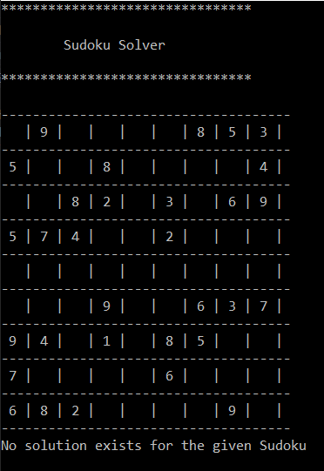
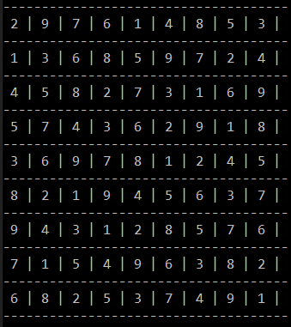
C++ Sudoku Solver
Once the program finishes attempting to solve the puzzle it will either show the completed Sudoku puzzle or print out a message stating that there is no solution to the puzzle.

Slide 16
C++ Rat in a Maze
My final project was a Rat in a Maze program in C++, I once again used Visual Studio to create this program.
The goal of the program is to use backtracking to find its way from the top left of a matrix to the bottom right by only moving forward and down.

Slide 17
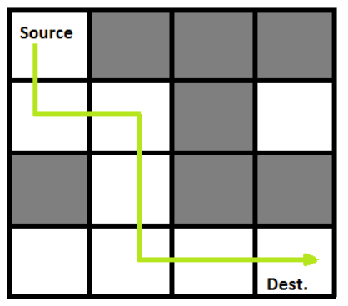
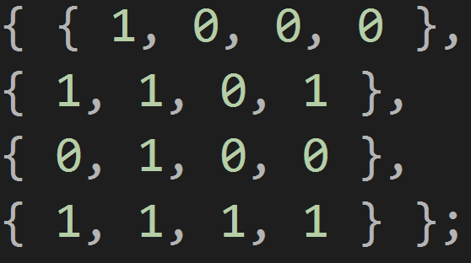
C++ Rat in a Maze
Example of a matrix maze
This program uses backtracking to find the solution to a matrix maze. It starts at the "1" in the top left and has to reach the exit which is the "1" at the bottom right. The one's and zero's in the matrix are the paths and walls of the maze; one's are the paths and zero's are walls.
Unsolved Maze

Slide 18
C++ Rat in a Maze
The program attempts to find its way through the maze by moving only forward and down and while doing so it will place a "1" on each space it has passed in the matrix and then backtrack if it places a "1" in an invalid location.

Slide 19

C++ Rat in a Maze
The program will repeat this process until it reaches the end of the maze or it deems there is no solution which it will then print out a message stating that a solution does not exist.
Unsolved Maze Solved Maze

Slide 20
C++ Rat in a Maze
The way the program completes this backtracking is by using multiple loops and if statements to check that the path it is attempting to make through them is valid.
While moving through the loops to get through the maze it will backtrack when an if statement returns a false, in which case it will attempt it again and if it returns false once more the program will deem that there is no solution to the maze and print a message stating so.

Slide 21
Java Chatbot Reflection
I believe that this was my favorite of the three projects that I completed.
I enjoyed working with Java and JFrame because it is probably the language I used most throughout my college classes.
My main problem with the programming was that I had to freshen up on 2D arrays because I have not really worked with them too much.
My favorite part about this project was how much freedom it gave you in choosing how and what the chatbot could respond to.

Slide 22
C++ Sudoku Solver Reflection
I felt that I was prepared to start this project, because I am fairly familiar with the C++ programming language.
The hardest part about this was wrapping my head around backtracking, I had to do a lot of research into it and I am still not entirely sure I know all about it.
With that being said I am glad I took the challenge of trying something new and learning about backtracking.

Slide 23
C++ Rat in a Maze Reflection
Carrying on from the Sudoku solver I had a little more knowledge of backtracking and decided to try another project with it, while it was still fresh in my mind.
I encountered the same problems though and had to continue looking into backtracking, and on top of that for this specific project I also needed to do a little research into matrixes because they were also a new concept to me.
In the end though I learned more about C++ and want to look more into both backtracking and matrixes at another time.

Slide 24
Overall Reflection
Overall I thoroughly enjoyed this project and am glad I got the opportunity to work on it.
At first it was a little overwhelming not being given much direction to go on and needing to choose all of our projects by ourselves.
This showed me one major problem I had, which was time management, at the start of the project I was not putting nearly enough time into my work.
This changed about halfway though my second project when I realized that I would need to put much more work in if I wanted to complete the project on time.
In the end though I completed everything and I am glad I did because I learned a lot more about programming and a little about my own work ethic in the process

Slide 25
Works Cited
Arend Peter Teaches. (2012, August 9). “Chat Bot” Java Tutorial. YouTube. https://www.youtube.com/watch?v=a8RUmnPL8aQ
GeeksforGeeks. (2017, July 26). Rat in a Maze | Backtracking (Set 2) | GeeksforGeeks. YouTube. https://www.youtube.com/watch?time_continue=227&v=PwxGTHraMNg&feature=emb_title
Rat in maze problems, how to display coordinates where rat stepped in random generated matrix? (2020, March 12). Stack Overflow. https://stackoverflow.com/questions/60659992/rat-in-maze-problems-how-to-display-coordinates-where-rat-stepped-in-random-gen
Seif, G. (2019, January 7). Solving Sudoku using a simple search algorithm - George Seif. Medium. https://medium.com/@george.seif94/solving-sudoku-using-a-simple-search-algorithm-3ac44857fee8

